Slide 1
Customer Management
Thirumalesh Gundrath(u01283768)
Saikrishna Thatipamula(u01313677)

Slide 2
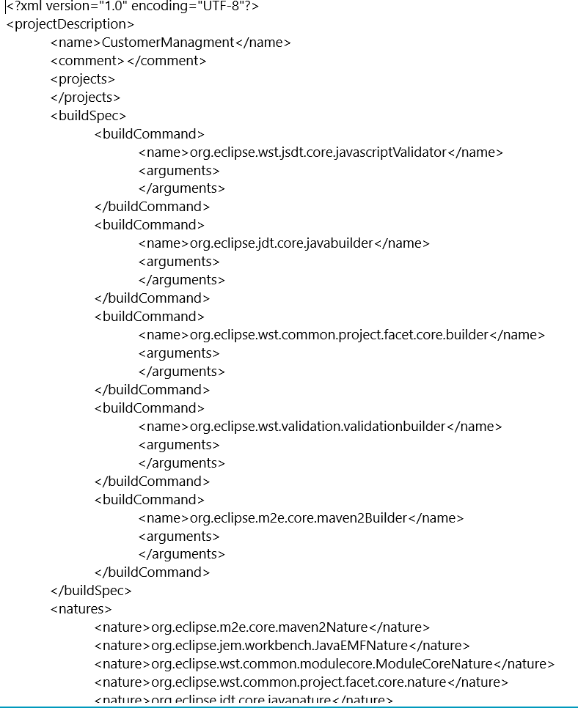
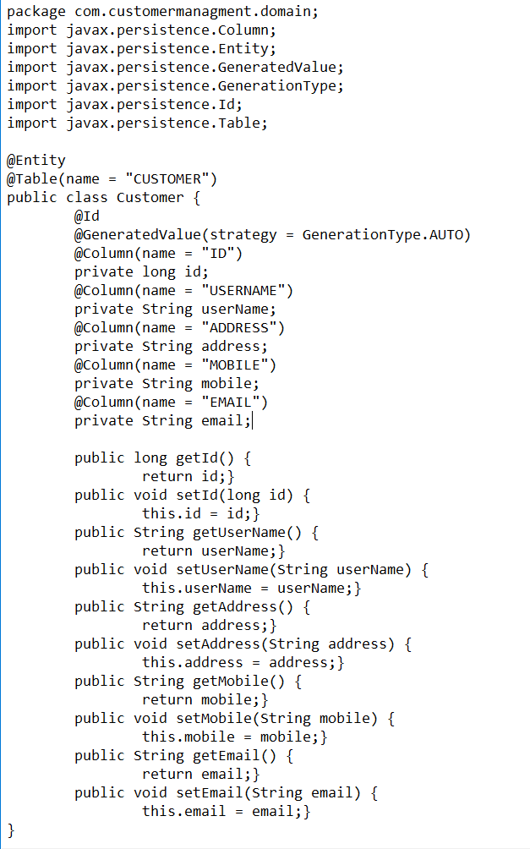
Customer Management
Customer: ID
Customer: USERNAME
Customer: ADDRESS
Customer: MOBILE
Customer: EMAIL

